Slide 1
潍坊祥和国际贸易有限公司
Weifang xianghe international trade co., ltd.
刹车片专业生产商
A Professional Manufacturer of Brake Pads
Business Contact: Yin Xianzheng
电话/TEL:130 7078 0106
E-mail:xianghe1234562024@126.com

Slide 2
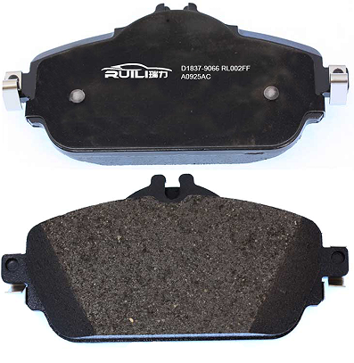
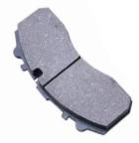
一、 公司简介/Company Profile
The company is located in Guangrao County, Dongying City, Wharf Economic and Technological Development Zone
The company covers an area of 12,000 square meters, with a planned total investment of 20 million.
Design production capacity: 1.2 million sets of automotive brake pads per year.
Primary markets: domestic and international mainframe markets, as well as high-end after-sales markets. Products are primarily sold in Central Asia, Russia, and Belarus.
Brake pads
盘式刹车片
CV pads
商用车刹车片

Slide 3
专业的技术团队/A team of skilled professionals
The technology center is led by experienced engineering researchers, and it employs more than 10 personnel with bachelor’s degrees or higher in engineering and scientific research, covering various aspects such as product design, formula design, material testing, experiment programming, and product inspection.
The team members have experience in supplying to Volkswagen, Ford, General Motors, TRW, Bosch, Delphi, Continental, Chrysler, as well as domestic original equipment manufacturers and brake manufacturers, and are capable of developing and producing products in response to market demands.
Product inspection
Product design
to program
and
test
Formula design
Material testing

Slide 4




环保稳定的原材料来源
A stable and eco-friendly source of raw materials
Weifang xianghe is dedicated to the research and development of eco-friendly formulations, and the key raw materials used in these formulations are all imported, ensuring the quality of the materials.
Rui Li Product Guarantee:
1. Non-asbestos;
2. It does not contain heavy metal pollutants such as lead, cadmium, mercury, or nickel.
3. It fully complies with all national laws and regulations.
Currently, we are using lead-free copper and have a well-established formula for lead-free ceramics, which has been in use since 2021.

Slide 5
完善的研发流程A well-developed research and development process
Clearly define the input required from the customer.
Heat treatment
Install the additional components
Mixing material
Grinding and data collection
Formula design
Bench testing
Corrosion by heat
Thermal pressing
Electrostatically applied powder coating
Preparation and organization of the report

Slide 6
全面的配方体系A comprehensive formulation system
半金属配方
Semi-metallic formula
少金属配方
Low-metal formulation
NAO陶瓷配方
NAO Ceramic Formula
多铜陶瓷配方Copper-rich ceramic formula
无铜陶瓷配方Ceramic formula without copper
少铜陶瓷配方Low-copper ceramic formula

Slide 7
三 、 生产过程与质量控制-先进的生产设备Production Process and Quality Control – Advanced Production Equipment
The company boasts excellent hardware facilities, including specialized equipment for brake pad production, such as blenders, compression machines, heat treatment chambers, groove-cutting, bevel-grinding, ablation machines, and powder coating lines. These machines are at the forefront of the industry in China, characterized by high overall automation, efficiency, long service life, and stable product quality.
The advanced production equipment and technologies ensure the reliability and stability of product quality, and they fully meet the standards for main equipment components.

Slide 8
制造过程流程图
Manufacturing process flow diagram
Heat treatment
Labeling with a spray pen
Mixing material
Grinding
Spraying adhesive onto a steel backing
Install the additional components
Corrosion by heat
Thermal pressing
Electrostatically applied powder coating
Packing

Slide 9
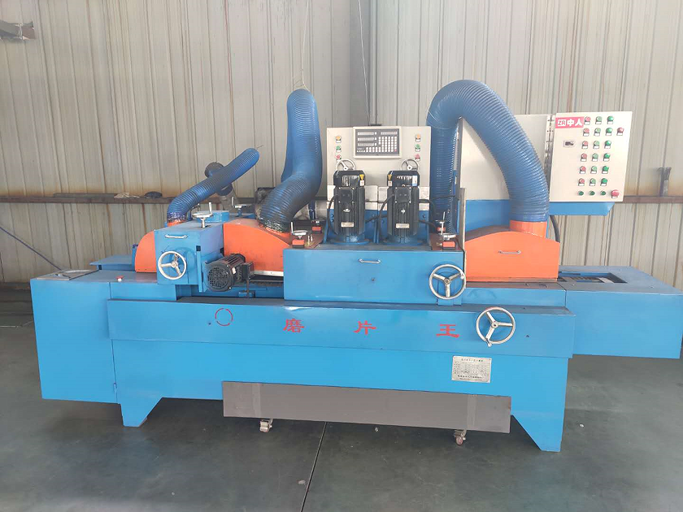
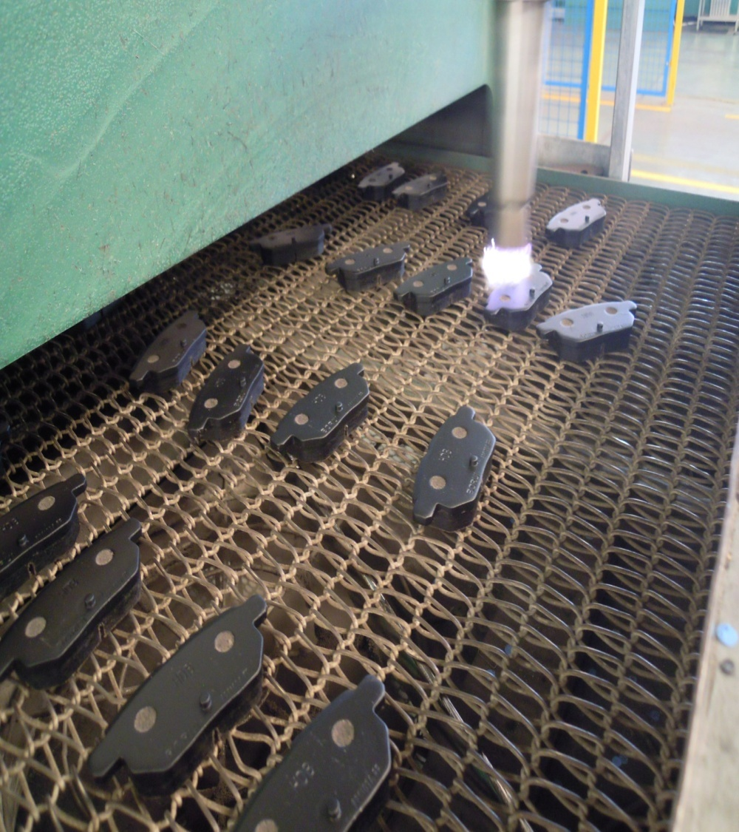
生产线Production line
The company's production line boasts high levels of automation, ease of operation, and stability. The product's groove-cutting, bevel-grinding, and powder-coating processes are fully automated, resulting in high production efficiency and minimizing the risk of human error.

Slide 10
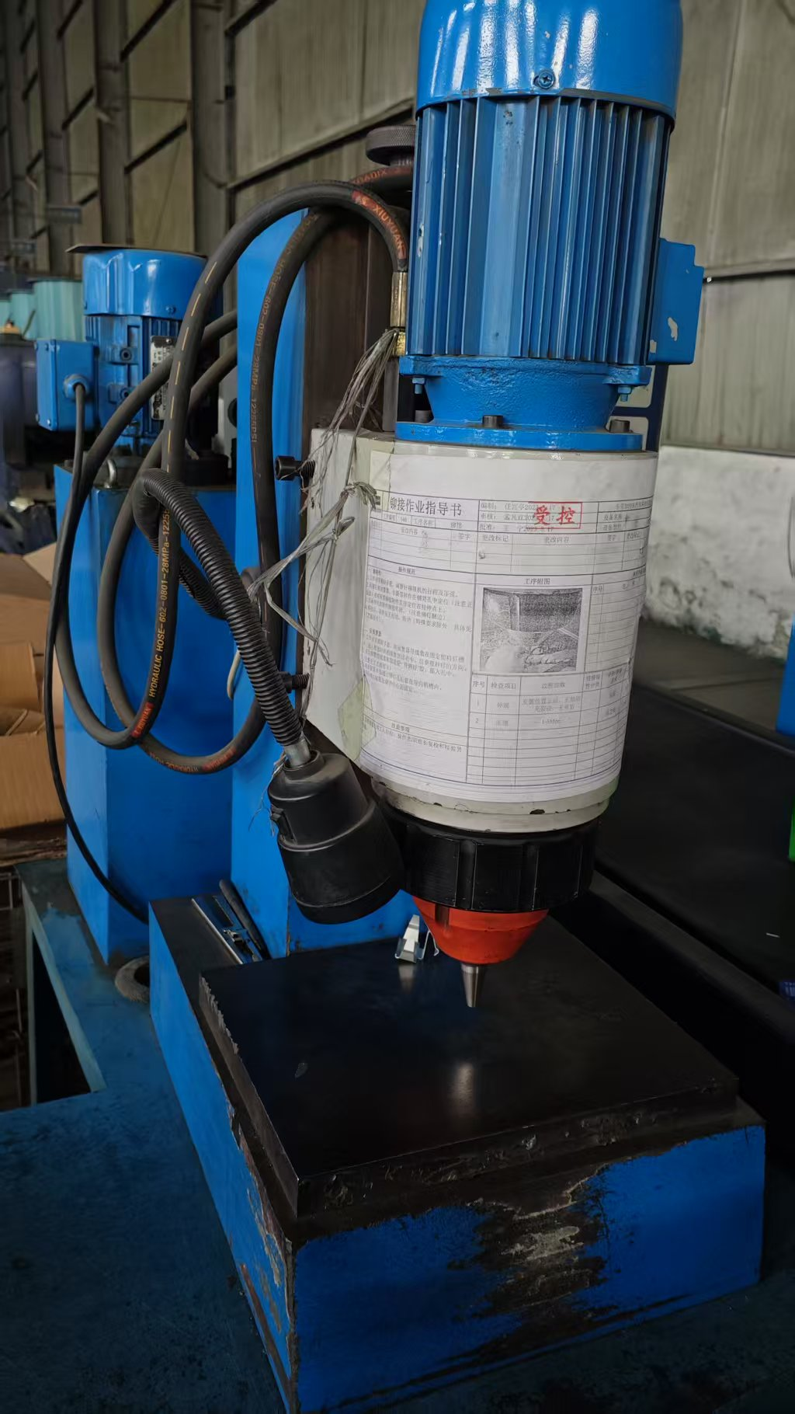
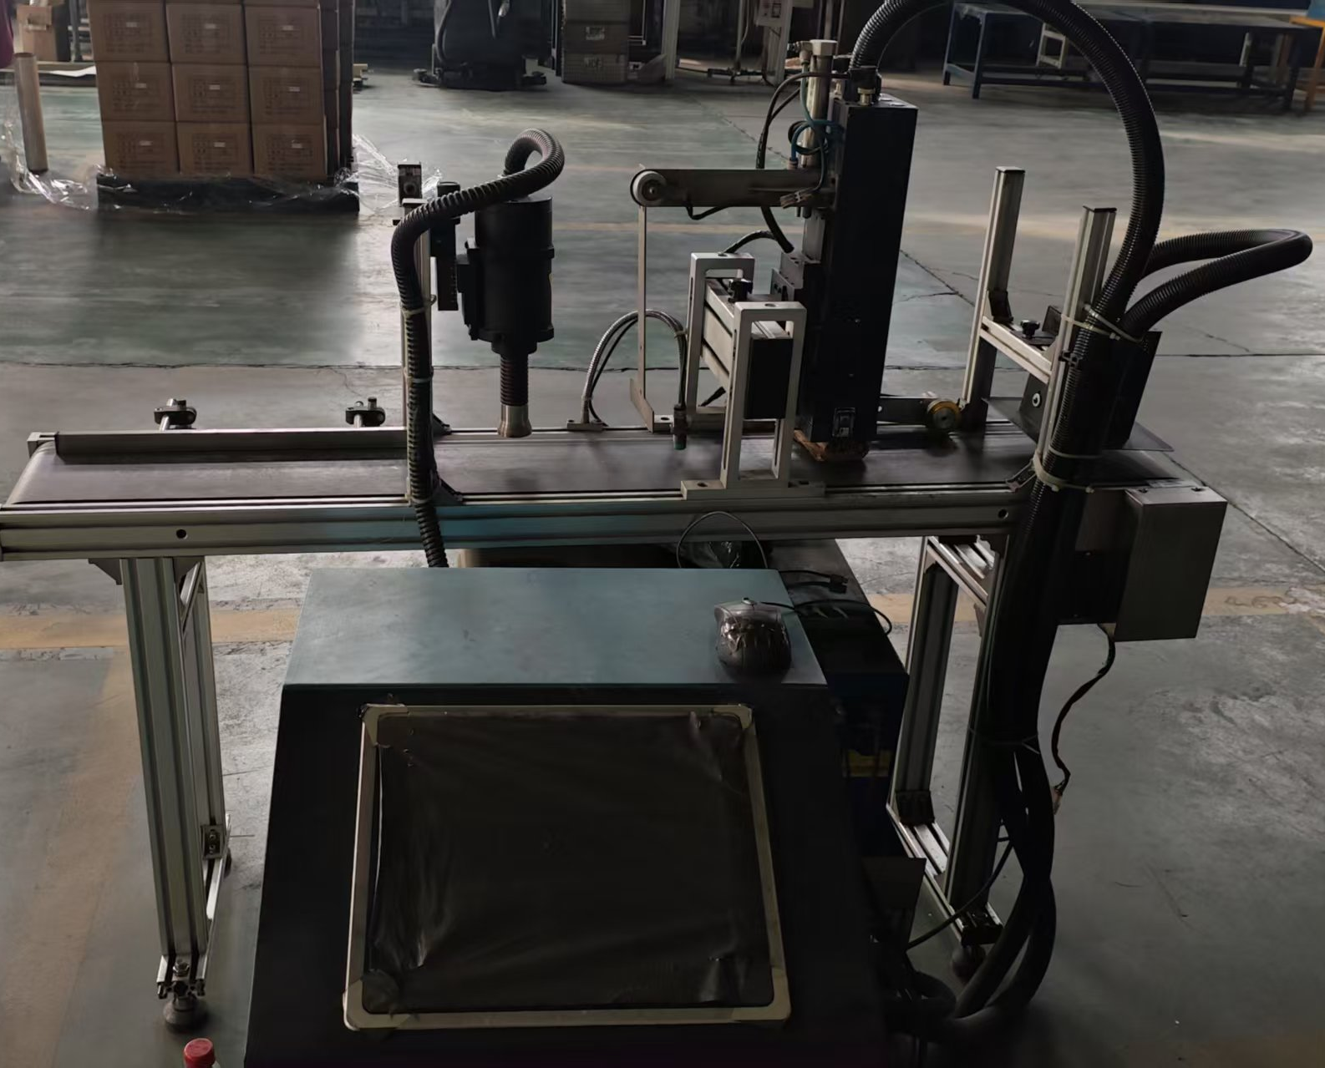
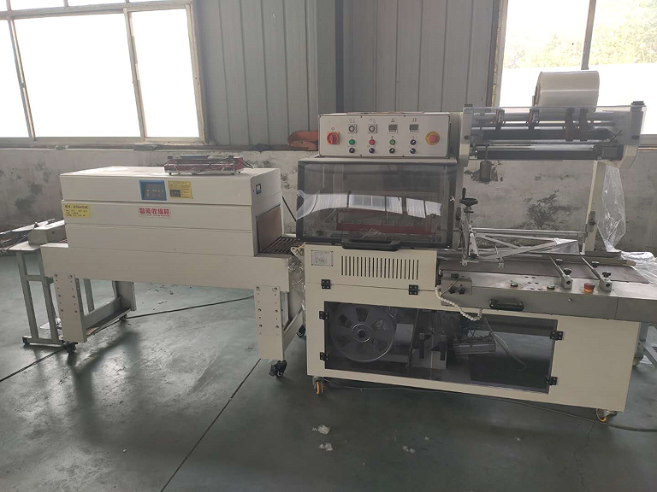
完善的包装操作流程，先进的激光UV喷码机

